Slide 1
Stages of ARIMA Modeling
Stage 1 Identify the key features of the data and check for stationarity
Stage 2 Preselect models that are compatible with time series characteristics
Stage 3 Estimate model parameters
Stage 4 Select best model using an information criterion.
Stage 5 Perform visual and analytical diagnostics procedures

Slide 2
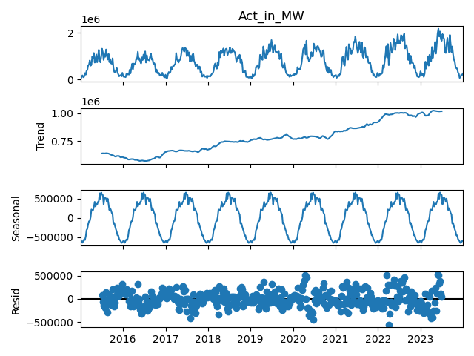
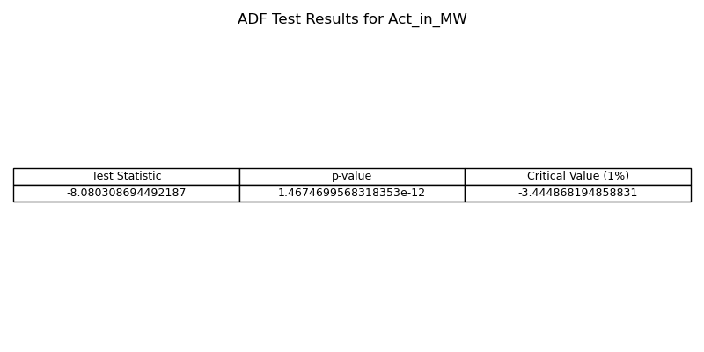
Check for stationarity of time series
Stationary Time Series: It maintains consistent mean, variance, and autocorrelations over time.
  Time Series Analysis: Involves analyzing plots and decomposing features to identify trends, seasonal patterns, and noise.
  Augmented Dickey-Fuller (ADF) Test: Essential for checking the stationarity of a time series.
It provides:
  Test Statistic: Indicates the strength of rejection against non-stationarity.
  p-value: Indicates the probability of observing the test statistic if non-stationarity is true.
  Critical Values: Thresholds for rejecting non-stationarity.

Slide 3
Key Concepts in ARIMA Time Series Analysis
ARIMA model: A forecasting method that combines AutoRegression (AR), differencing, and Moving Average (MA) components to analyze and predict time series data.
  AR: Represents the relationship between an observation and its past values in time series analysis.
  Relation with ACF: ACF plot helps identify the order of the AR component in an ARIMA model by showing when autocorrelations become non-zero.
  MA: Represents the relationship between an observation and random error terms in time series analysis.
  Relation with PACF: PACF plot helps identify the order of the MA component in an ARIMA model by showing direct correlations between observations at different lags.
  Differencing: A transformation in time series analysis to make data stationary.
AIC (Akaike Information Criterion): Balances model fit and complexity, guiding model selection by quantifying relative model quality.

Slide 4
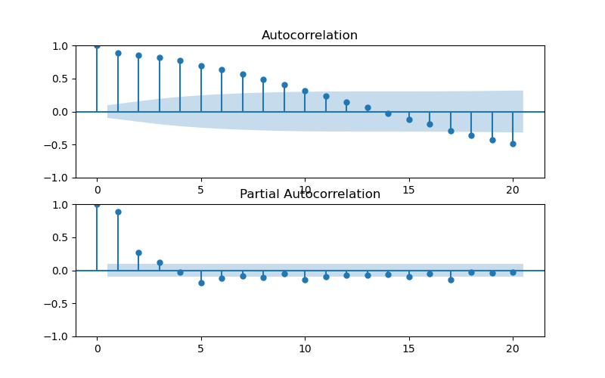
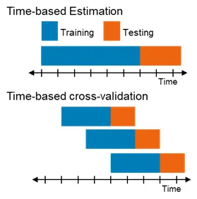
Estimate ARIMA(p,d,q) model parameters
ACF plot and PACF plot: These plots provide insights into the autocorrelation and partial autocorrelation structures of the time series data.
Time series cross-validation sequentially splits the data based on time to preserve the temporal order of observations, enabling the determination of the best parameter.

Slide 5
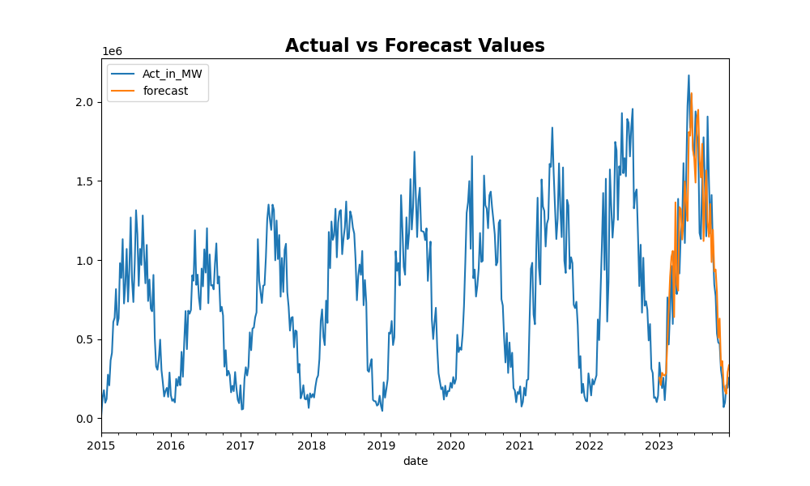
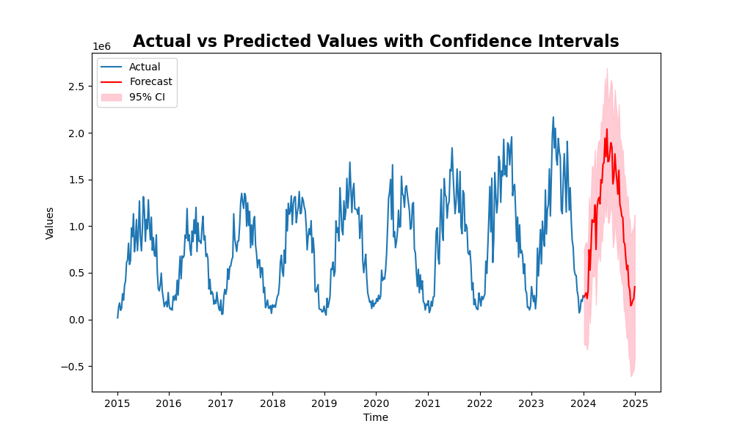
Forecasting with ARIMA Models
SARIMAX model with the following parameter estimates: Non-seasonal Component: (1, 1, 1), Seasonal Component: (1, 1, 0, 52)
we obtain the following insights:
AIC = 11480.522.
The residual variance = 6.744e+10, indicating the variability of data points around the fitted values.
Diagnostic tests: (Ljung-Box = 0.02, JB = 34.87)
  The data shows autocorrelation (Ljung-Box test p-value < 0.05)
  The data is not normally distributed (Jarque-Bera test p-value < 0.05)

Slide 6
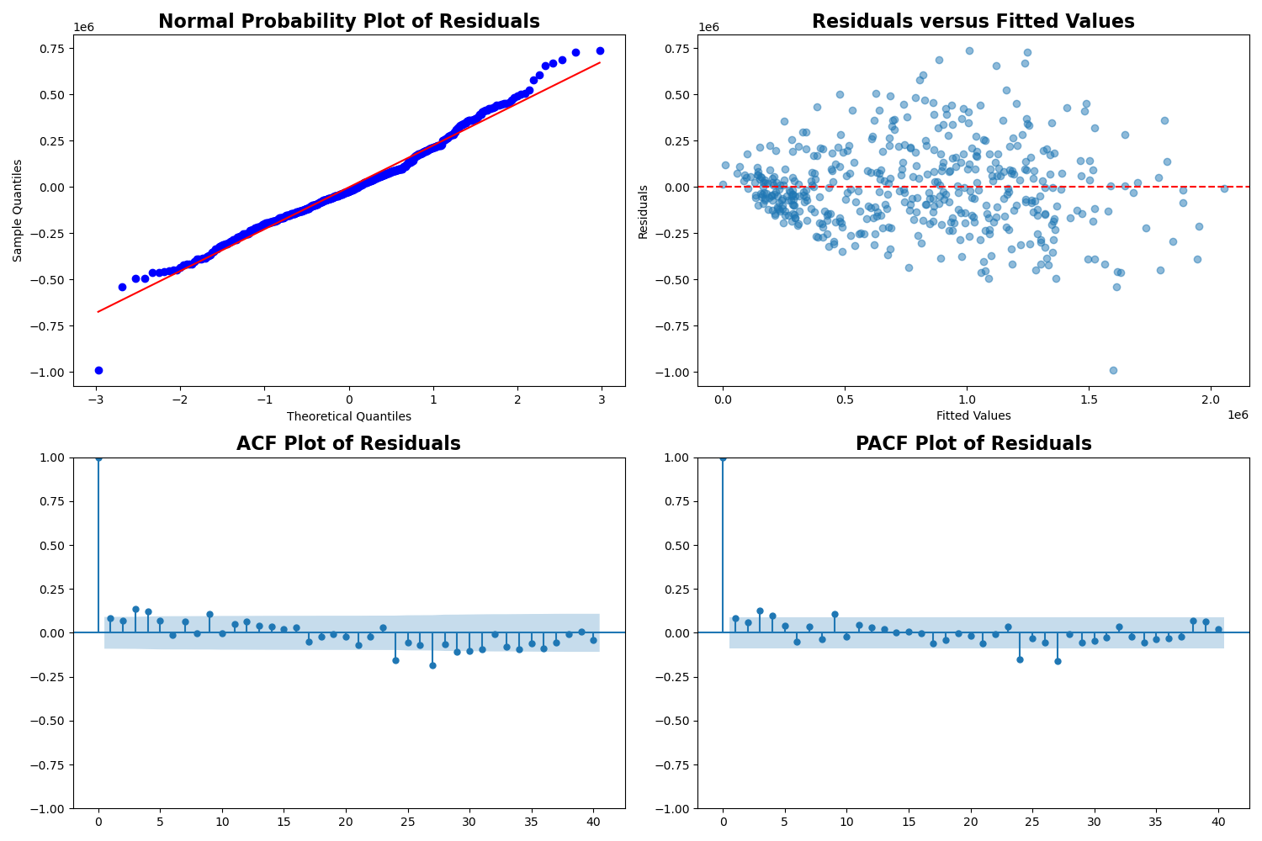
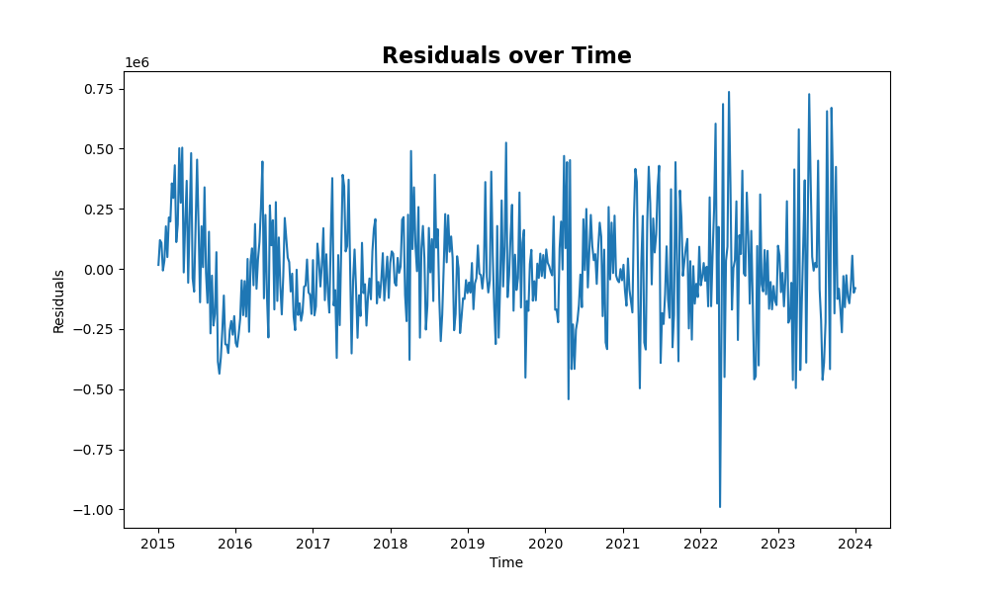
Model Diagnostics
What can go wrong?
  The errors may not be normally distributed
  The data ma contain outliers.
  The time series may be non-stationary.
  The erors may show changing variances over time.
  The mean of the errors may be non-zero
How do we check for these problems:
  Normal probability plot of residuals
  Residuals versus fitted values
  Residuals versus observation order
  ACF/PACF plot of residuals

